Slide 1

Title: Developing auction strategy for new IPL franchise by analyzing past IPL data to create a strong and balanced squad. Presented By: Agisham Dinesh Date: 26-Dec-2023

Slide 2
Creating Table IPL_Ball
create table IPL_Ball (
id int ,
inning int,
over int,
ball int,
batsman varchar,
non_striker varchar,
bowler varchar,
batsman_runs int,
extra_runs int,
total_runs int,
is_wicket boolean,
dismissal_kind varchar,
player_dismissed varchar,
fielder varchar,
extras_type varchar,
batting_team varchar,
bowling_team varchar);
copy IPL_Ball from 'C:\Program Files\PostgreSQL\15\data\data copy\IPL_Ball.csv' delimiter ',' csv header;

Slide 3
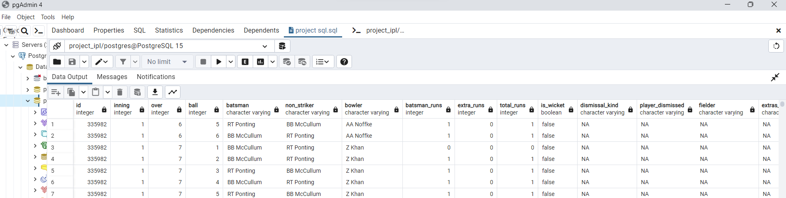
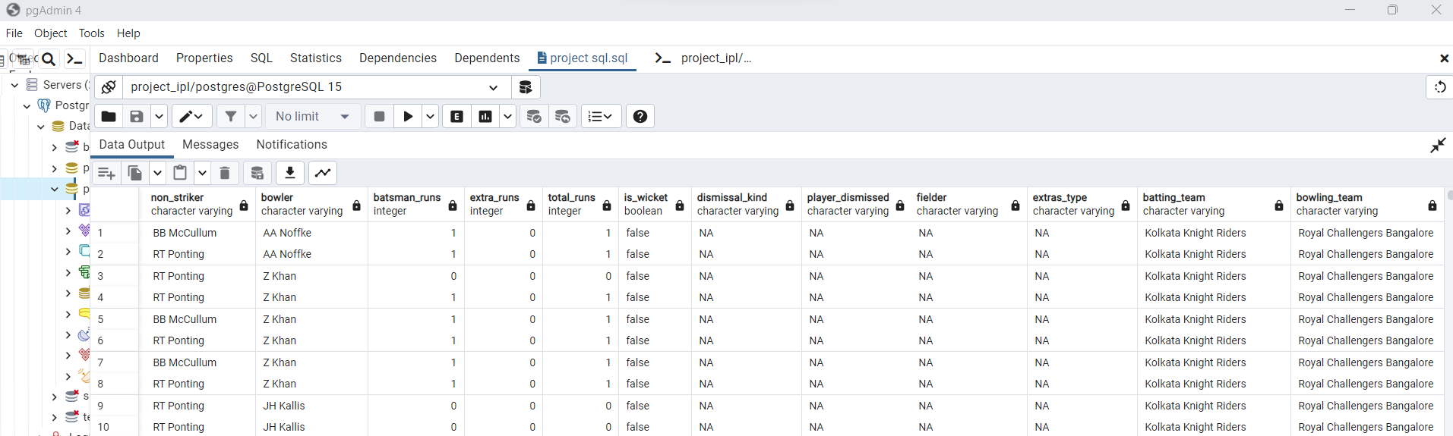

Slide 4
create table IPL_Matches (
id int primary key,
city varchar,
date Date,
player_of_match varchar,
venue varchar,
neutral_venue boolean,
team1 varchar,
team2 varchar,
toss_winner varchar,
toss_decision varchar,
winner varchar,
result varchar,
result_margin int,
eliminator varchar,
method varchar,
umpire1 varchar,
umpire2 varchar
);
copy IPL_Matches from 'C:\Program Files\PostgreSQL\15\data\data copy\IPL_matches.csv' delimiter ',' csv header;

Slide 5
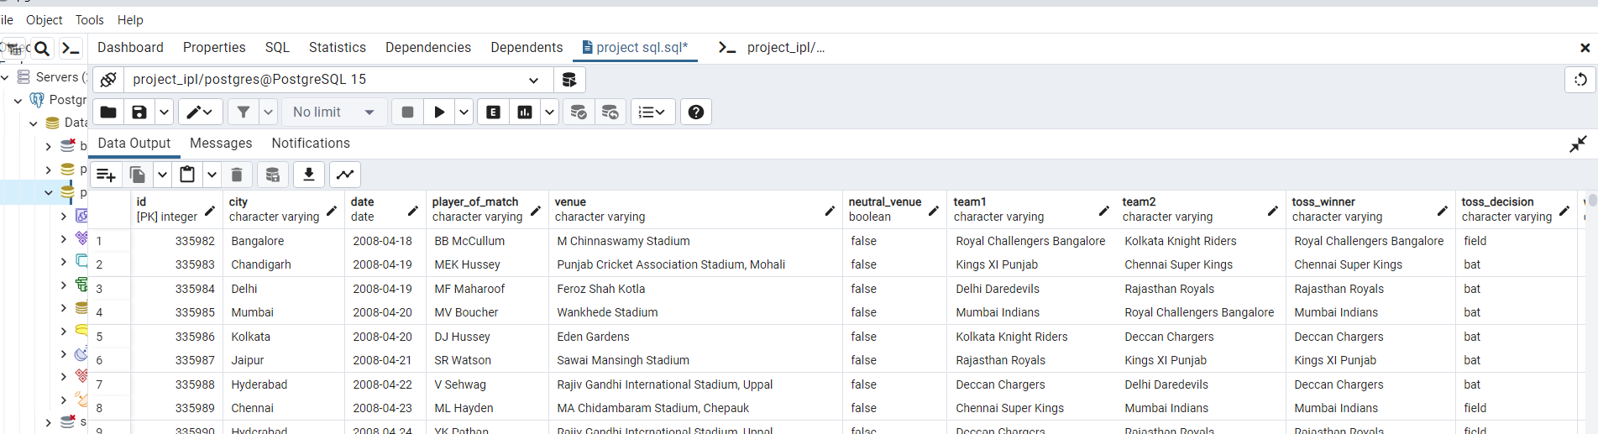

Slide 6
1. Your first priority is to get 2-3 players with high S.R who have faced at least 500 balls.And to do that you have to make a list of 10 players you want to bid in the auction so that when you try to grab them in auction you should not pay the amount greater than you have in the purse for a particular player.
select batsman,
sum(batsman_runs) as total_runs,
count(ball) as total_balls_faced ,
(sum(batsman_runs) * 100.0) / count(ball) as strike_rate
from IPL_Ball
where extras_type != 'wides'
group by batsman
having count(ball) >= 500
order by strike_rate desc
limit 10;

Slide 7
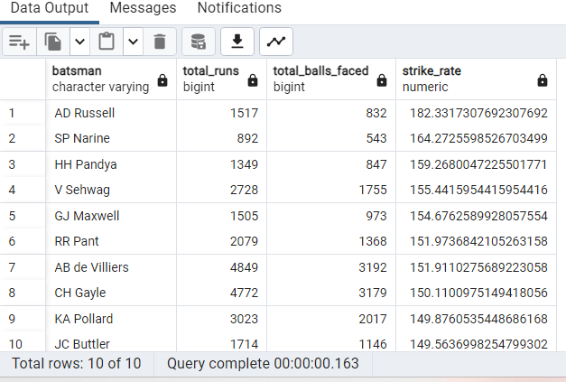
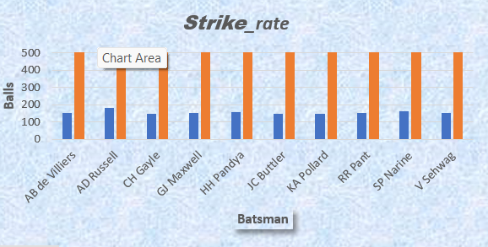
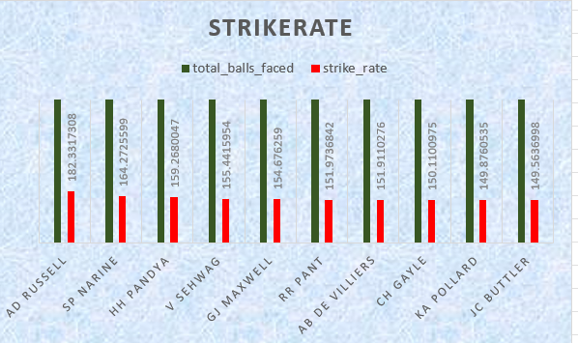

Slide 8
2. Now you need to get 2-3 players with good Average who have played more than 2 ipl seasons. And to do that you have to make a list of 10 players you want to bid in the auction so that when you try to grab them in auction you should not pay the amount greater than you have in the purse for a particular player.
select
batsman,
count(distinct extract( year from date)) as seasons_played,
sum(batsman_runs) as total_runs,
count(case when is_wicket then 1 end) as wicket_ball,
sum(batsman_runs)/ nullif( count(case when is_wicket then 1 end), 0) as avg_runs
from IPL_Ball
inner join IPL_Matches on IPL_Ball.id = IPL_Matches.id
group by batsman
having
count(distinct extract(year from date)) >2
and count(ball) > 500
order by avg_runs desc
limit 10;

Slide 9
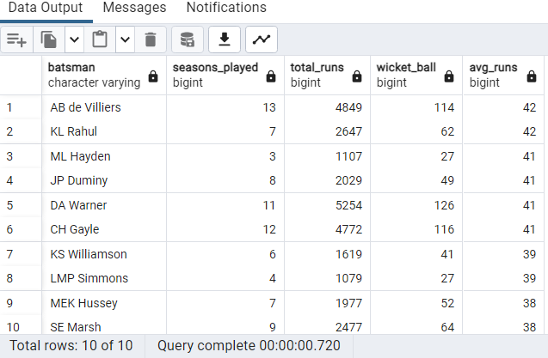
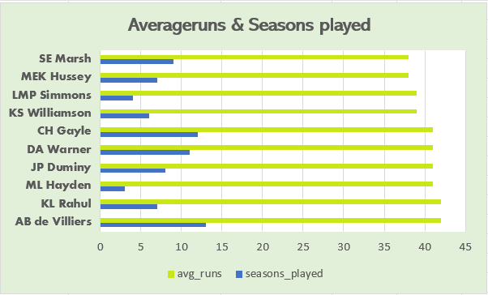

Slide 10
3. Now you need to get 2-3 Hard-hitting players who have scored most runs in boundaries and have played more the 2 ipl season. To do that you have to make a list of 10 players you want to bid in the auction so that when you try to grab them in auction you should not pay the amount greater than you have in the purse for a particular player.
select a.batsman,
count(distinct extract ( year from b.date)) as seasons_played,
sum(a.batsman_runs) as total_runs,
sum(case when a.batsman_runs in (4 ,6 ) then 1 else 0 end) as total_boundries
from IPL_Ball as a
inner join
IPL_Matches as b on a.id = b.id
group by a.batsman
having count( distinct extract (year from b.date)) >2
and sum(case when a.batsman_runs in (4 ,6 ) then 1 else 0 end) >0
order by total_boundries desc
limit 10;

Slide 11
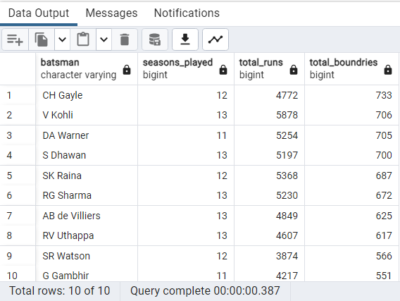
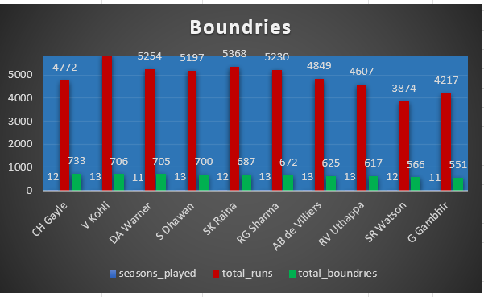

Slide 12
4. Your first priority is to get 2-3 bowlers with good economy who have bowled at least 500 balls in IPL so far.To do that you have to make a list of 10 players you want to bid in the auction so that when you try to grab them in auction you should not pay the amount greater than you have in the purse for a particular player
select bowler,
sum(total_runs) as total_runs_given,
sum(total_balls) / 6 as total_overs_bowled,
sum(total_runs) * 6.0 / sum(total_balls) as economy_rate,
sum(case when is_wicket = 1 then 1 else 0 end) as total_wickets,
sum(total_balls) / sum(case when is_wicket = 1 then 1 else 0 end) as strike_rate
from (
select
bowler,
sum(batsman_runs) as total_runs,
count(ball) as total_balls,
sum(case when dismissal_kind in ('caught', 'lbw', 'bowled') then 1 else 0 end) as is_wicket
from IPL_Ball
where extras_type != 'wide'
group by bowler, id
)as bowler_stats
group by bowler
having sum(total_balls)>= 500
order by economy_rate asc, strike_rate asc
limit 10;

Slide 13
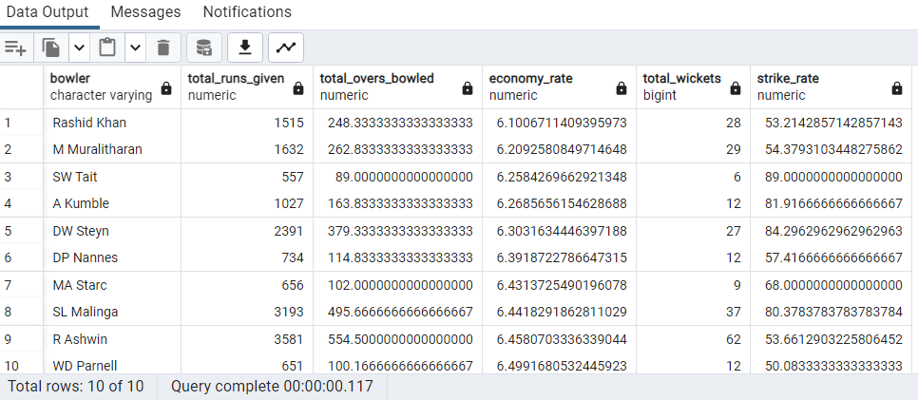
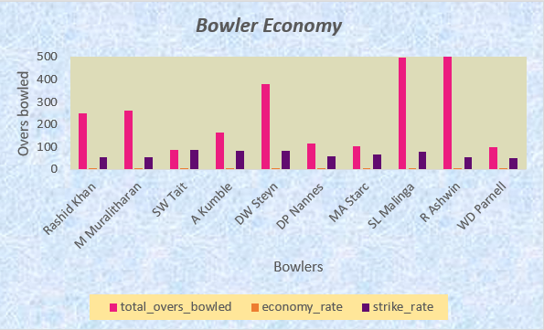

Slide 14
5. Now you need to get 2-3 bowlers with the best strike rate and who have bowled at least 500 balls in IPL so far.To do that you have to make a list of 10 players you want to bid in the auction so that when you try to grab them in auction you should not pay the amount greater than you have in the purse for a particular player.
select bowler,
sum(total_runs) as total_runs_given,
sum(total_balls) / 6 as total_overs_bowled,
sum(case when is_wicket = 1 then 1 else 0 end) as total_wickets,
sum(total_balls) / sum(case when is_wicket = 1 then 1 else 0 end) as strike_rate
from (
select bowler,
sum(batsman_runs) as total_runs,
count(ball) as total_balls,
sum(case when dismissal_kind in ('caught', 'lbw', 'bowled') then 1 else 0 end) as is_wicket
from IPL_Ball
where extras_type != 'wide'
group by bowler, id
)as bowler_stats
group by bowler
having sum(total_balls)>= 500
order by strike_rate asc
limit 10;

Slide 15
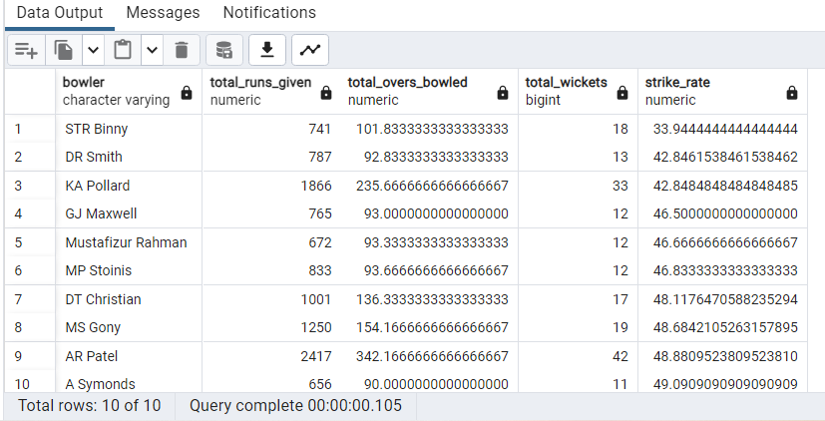
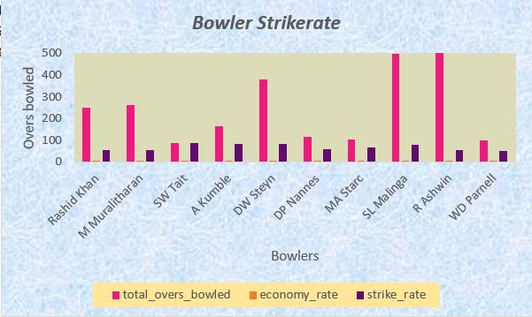

Slide 16
6. Now you need to get 2-3 All_rounders with the best batting as well as bowling strike rate and who have faced at least 500 balls in IPL so far and have bowled minimum 300 balls.To do that you have to make a list of 10 players you want to bid in the auction so that when you try to grab them in auction you should not pay the amount greater than you have in the purse for a particular player
select
batsman as player_name,
sum(case when dismissal_kind is not NULL then 1 else 0 end) as total_dismissals,
sum(batsman_runs) as total_runs_scored,
sum(case when is_wicket::INT = 1 then 1 else 0 end) as total_wickets_taken,
count(ball) as total_balls_bowled,
count(ball) * 1.0 / nullif(sum(case when is_wicket::INT = 1 then 1 else 0 end), 0) as bowling_average,
sum(batsman_runs) * 1.0 / nullif(sum(case when dismissal_kind is not NULL then 1 else 0 end), 0) as batting_average,
(sum(batsman_runs) * 100.0) / count(ball) as batting_strike_rate,
count(ball) * 1.0 / nullif(sum(case when is_wicket::INT = 1 then 1 else 0 end), 0) as bowling_strike_rate
from
IPL_Ball
group by
batsman
having
count(ball) >= 500 and count(ball) >= 300
order by
batting_strike_rate desc, bowling_strike_rate desc
limit 10;

Slide 17
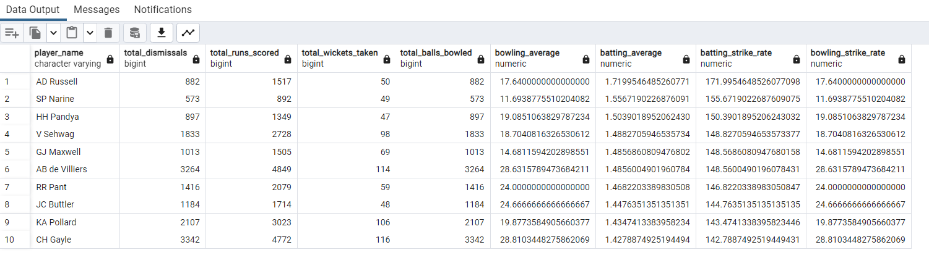
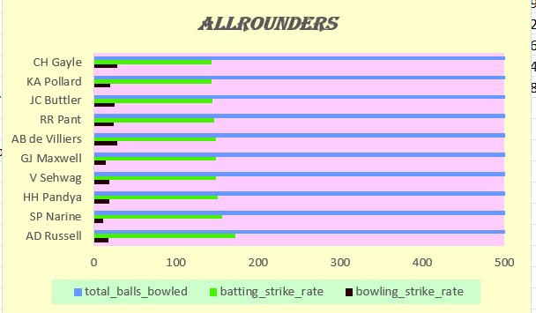

Slide 18
Wicketkeeper
In cricket, the wicketkeeper, often referred to as the "keeper" or "wicketkeeper," plays a crucial role as a fielding specialist behind the stumps. Here's a detailed explanation of the wicketkeeper's role, responsibilities, skills, and equipment:
Role and Responsibilities:
Catching: The primary duty of the wicketkeeper is to catch balls delivered by the bowler. They stand behind the stumps to intercept balls that the batsman misses or edges.
Stumping: The wicketkeeper can attempt to dismiss a batsman by quickly removing the bails from the stumps if the batsman moves out of their crease and misses the ball. This is known as a stumping.
Run-outs: They are involved in attempting run-outs by receiving throws from fielders and attempting to break the stumps before the batsman reaches the crease.
Communication: The keeper communicates with bowlers and fielders, providing insights on the batsman's play, suggesting bowling changes, and assisting in setting the field.
Skills Required:
Catching Ability: A wicketkeeper must have exceptional catching skills as they need to react quickly to edges and chances behind the stumps.
Agility and Reflexes: Quick reflexes and agility are crucial for the keeper to move swiftly in response to the ball's trajectory.
Footwork: Good footwork allows the keeper to adjust quickly to deliveries, enabling them to position themselves for catching or stopping the ball.
Concentration: Maintaining concentration throughout the match, even during long periods of inactivity, is essential as the keeper must be ready to react to any sudden opportunities.

Slide 19
Additional Questions for Final Assessment
Get the count of cities that have hosted an IPL match
select count(distinct city) as count_cities
from IPL_Matches;
Create table deliveries_v02 with all the columns of the table ‘deliveries’ and an additional column ball_result containing values boundary, dot or other depending on the total_run (boundary for >= 4, dot for 0 and other for any other number) (Hint 1 : CASE WHEN statement is used to get condition based results) (Hint 2: To convert the output data of the select statement into a table, you can use a subquery. Create table table_name as [entire select statement].
create table deliveries_v02 as
select *,
case when total_runs >= 4 then 'boundary'
when total_runs = 0 then 'dot'
else 'other'
end as ball_result
from IPL_Ball;

Slide 20
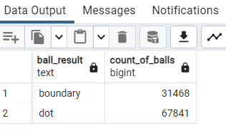
Write a query to fetch the total number of boundaries and dot balls from the deliveries_v02 table
select ball_result,
count(ball) as count_of_balls
from deliveries_v02
where ball_result in ('boundary','dot')
group by ball_result;

Slide 21
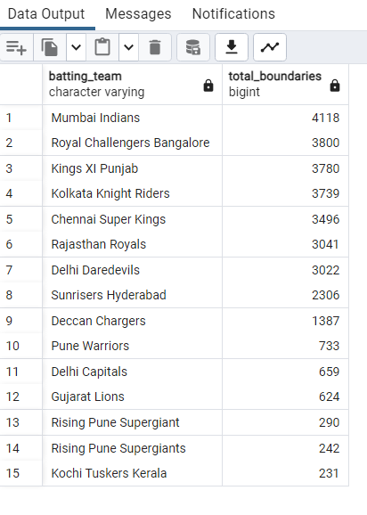
Write a query to fetch the total number of boundaries scored by each team from the deliveries_v02 table and order it in descending order of the number of boundaries scored.
select batting_team,
count(ball_result) as total_boundaries
from deliveries_v02
where ball_result ='boundary'
group by batting_team
order by total_boundaries desc;

Slide 22
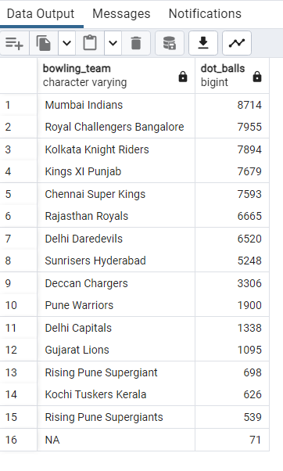
Write a query to fetch the total number of dot balls bowled by each team and order it in descending order of the total number of dot balls bowled.
select bowling_team,
count(ball_result) as dot_balls
from deliveries_v02
where ball_result = 'dot'
group by bowling_team
order by dot_balls desc;

Slide 23
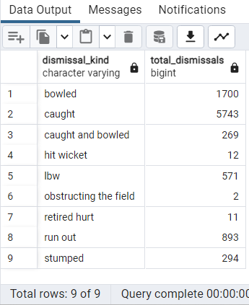
Write a query to fetch the total number of dismissals by dismissal kinds where dismissal kind is not NA
select dismissal_kind,
count(ball_result) as total_dismissals
from deliveries_v02
where dismissal_kind !='NA'
group by dismissal_kind;

Slide 24
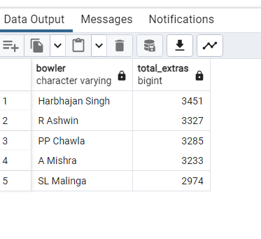
Write a query to get the top 5 bowlers who conceded maximum extra runs from the deliveries table
select bowler,
count(extra_runs) as total_extras
from deliveries
group by bowler
order by total_extras desc
limit 5;

Slide 25
Write a query to create a table named deliveries_v03 with all the columns of deliveries_v02 table and two additional column (named venue and match_date) of venue and date from table matches
create table deliveries_v03 as
select a.*, b.venue,b.date
from deliveries_v02 as a
join IPL_Matches as b on a.id = b.id;
Write a query to fetch the total runs scored for each venue and order it in the descending order of total runs scored.
select venue, sum(total_runs) as total_runs_scored
from deliveries_v03
group by venue
order by total_runs_scored;

Slide 26
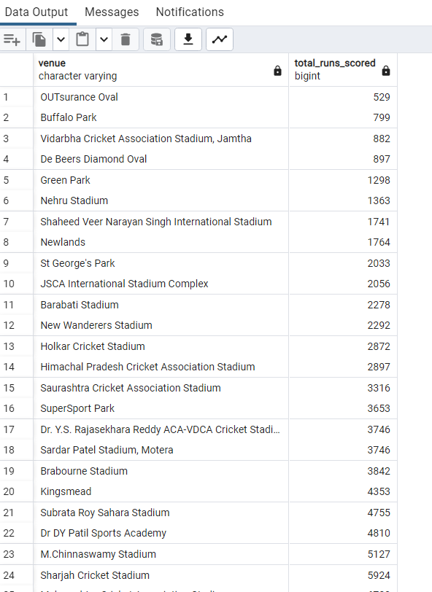
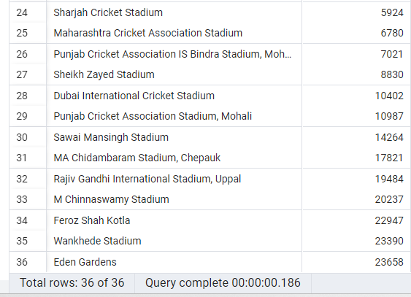

Slide 27
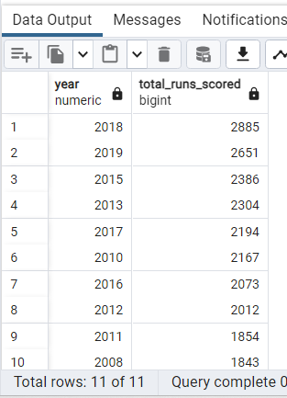
Write a query to fetch the year-wise total runs scored at Eden Gardens and order it in the descending order of total runs scored.
select extract(year from date) as year,
sum(total_runs) as total_runs_scored
from deliveries_v03
where venue ='Eden Gardens'
group by year
order by total_runs_scored desc;

Slide 28







